Slide 1
Digital transformation of public administration in Romania: achieved results and future challenges
Michele Giove, EY Romania
september 2022

Slide 2

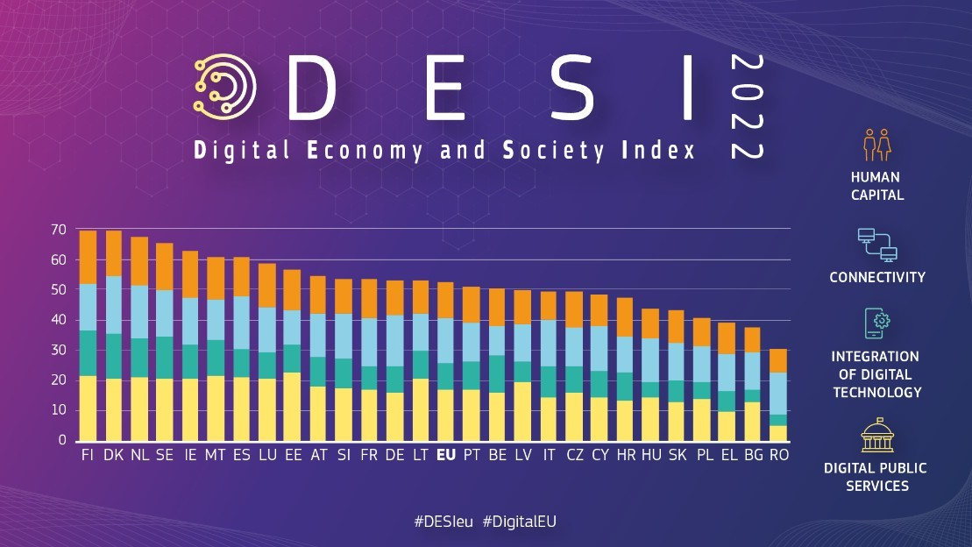
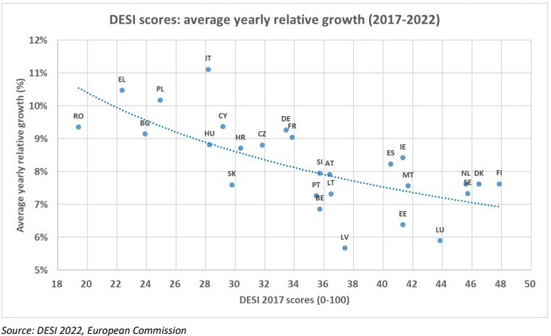
The digital divide of the Romanian Economy and Society
Human
Capital
27th
Connectivity
15th
Romania
DESI
27th
Digital
Public
Services
27th
Digital
Technologies
27th

Slide 3
The opportunities given by the Recovery and Resilience Plan
Romania’s Recovery and Resilience Plan has the objective to address most of the country’s digital shortcomings, contributing EUR 5.97 billion (i.e. 20.5% of Romania’s total allocation) to digital objectives. All components include some measures related to digital. Among the others:
  Digitalisation of the railway system
  Digitalisation of the tax and pensions authorities
  Support businesses’ digitalisation
  Foster participation in the digital public space
  Reforms and investments for the digitalisation of education
  Increasing digital competence for public service
  Adoption of the government cloud and interoperability

Slide 4
Transformarea digitală este utilizarea de către o entitate publică sau privată a soluţiilor oferite de tehnologia informaţiei pentru transformarea optimală a fluxurilor operative necesare îndeplinirii obiectului activităţilor specifice, precum şi utilizarea de către un ansamblu de entităţi a soluţiilor oferite de tehnologia informaţiei pentru asigurarea interoperabilităţii tehnice şi semantice a fluxurilor de date şi informaţii
Hotărârea nr. 89/2020 privind organizarea şi funcţionarea Autorităţii pentru Digitalizarea României

Slide 5
The Digital Transformation of the Public Administration
Design
Strategy & Legal
Governance
Operations
Data management
Key enablers
Usage of technologies
Internal
functioning
of the Public
Administration
Delivery of
digital public
services
Quality
Pre filled forms
User support
Mobile friendliness
Availability
Online
Mobile
Cross border services
Interoperability
Legal
Organisational
Semantic
Technical
Security
Cyber security
Data protection
Usage
Digital public services for citizens
Digital public services for businesses
e-Government users
Digital skills
of public sector
employees
Digital content
Communication and sharing
Security
Online services
Digital transformation
Environment
Connectivity
Broadband
4/5 G
Cross border collaboration
Foreign direct investments
Integration of digital technology
Activity in the digital field
Usage of technologies
Digital literacy of individuals
Human capital
Internet usage in households and by individuals
Innovation
Expenditure on R&D
Employment in R&D
Intellectual property rights
Start up environment

Slide 6



Key success factors
Leaderships & Governance
Competences
Paradigm Shift
Monitoring

Slide 7

Thank you for your attention!!

